Slide 1
Tencent Data Science Project
Yaswanth Chittepu

Slide 2
Anomaly Detection

Slide 3
Anomaly Detection:
Unsupervised Methods were used to detect anomalies.
K means Clustering and Isolation Forest approaches were utilized to detect anomalies
The Time stamps were utilized to generate additional features, to improve the performance of our Model.
Weekend
Month end
Month start
Month
Day

Slide 4
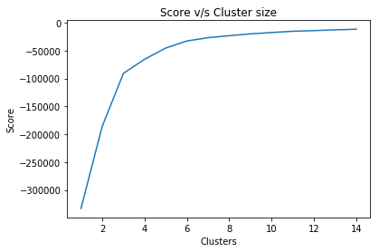
K-Means Clustering:
Standardize the data, and reduce the dimension down to 2, using Principal Component Analysis (PCA), so that we can plot our clusters
Then we run K-means clustering to generate our clusters
The number of Clusters (K) is chosen such that it maximizes the scores, which can be set to 6, from the plot.

Slide 5
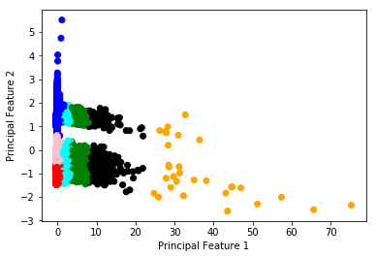
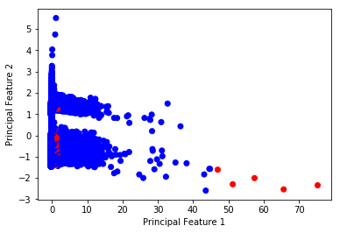
K-Means Clustering:
The Data points lying far away from the center of the cluster are labelled outliers
Plots of the data points in a 2D space, corresponding to the two largest principal components
The Left plots categorizes the data points into the 6 clusters
In the Right plot, the red data points represent the anomalous observations

Slide 6
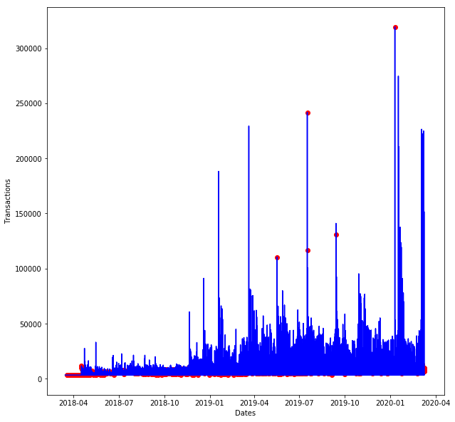
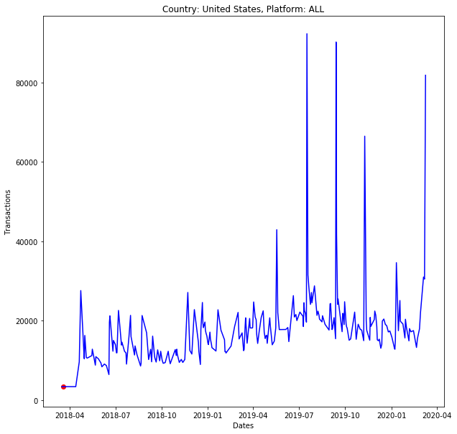
K-Means Clustering:
Plots in the Time series domain, for the Transaction feature variable vs Days
The Left plot is for all the data points, and the right plot contains the data points pertaining to ‘United States’ and ‘ALL’ Platform.

Slide 7
K-Means Clustering:
From the previous plots, we see that K-Means is not doing a good job of classifying the anomalous points.
It has labelled few of the spikes in the time series data as anomalous. But, most of the anomalous data that it has classified correspond to the lowest transaction values.
But it order to be a robust Anomaly classifier, it has to account for the spikes in the time series data. The gravity of the performance, can be felt, when we only consider the time series data for Transactions in United States, on ALL platforms.

Slide 8
Isolation Forest:
Isolation Forest is similar in approach to Random Forest, in that it uses Decision Trees for Classification.
But Isolation Forest makes use of the fact that anomalous data, comes from a different distribution, and hence are more easily separated into leaf nodes.
This translates to the fact that Anomalous data points are present in the Leaf nodes at the earlier levels of the tree, in an Isolation Forest.

Slide 9
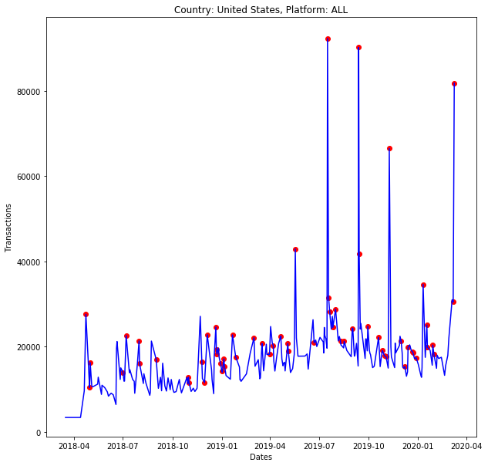
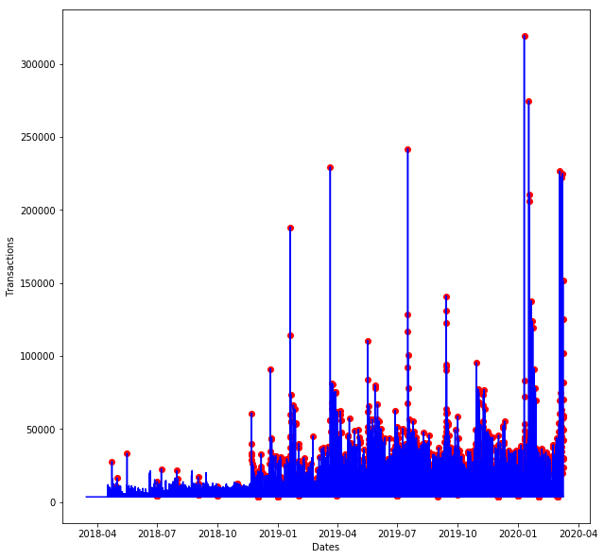
Isolation Forest:
Plots in the Time series domain, for the Transaction feature variable vs Days
The Left plot is for all the data points, and the right plot contains the data points pertaining to ‘United States’ and ‘ALL’ Platform.

Slide 10
Isolation Forest:
We see that Isolation Forest, is better able to capture anomalous data points, as it has captured the spikes in the time series data for transactions as anomalies. Hence, we will use the Isolation Forest model, to perform Anomaly detection on our time series data.
We see that the graphs display a general trend of growth, followed by stagnation.
The spikes in the data, correspond to deviations from the mean trend. If the deviation is of the orders of a couple of standard deviation, the data points are more likely to come from a deviant anomalous distribution

Slide 11
Predictive Model

Slide 12
Predictive Modelling:
The Time stamps were utilized to generate additional features, to improve the performance of our Model.
Weekend
Month end
Month start
Month
Day
The Current value of a feature, is dependent on its historical values
Features that lag, the current feature value, were considered and their rolling mean and exponentially weighted mean over a window, were calculated, to be used a features

Slide 13

Predictive Modelling:
Model Used: Light Gradient Boosted Model (LGBM)
Evaluation Metric: Symmetric Mean Absolute Prediction Error (SMAPE)
SMAPE is an accurate measure, based on percentage of relative errors
Where F corresponds to the Predicted value for the data point t, and A is its actual value

Slide 14
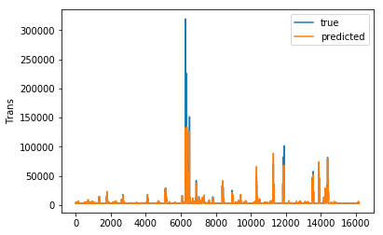
Predictive Modelling:
Validation data, was chosen to be the data points corresponding to the year 2020.
A comparison between the predicted and actual values, on the validation data is shown below, for the Transaction feature

Slide 15
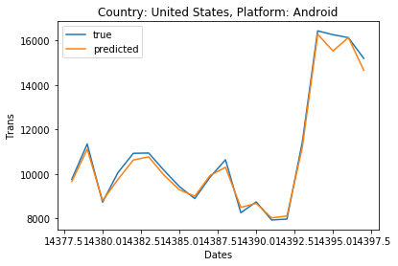
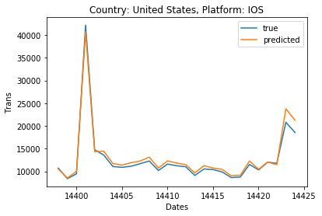
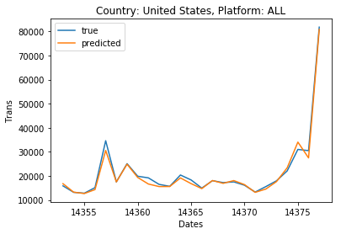
Predictive Modelling:
A comparison between the predicted and actual values, on the validation data is shown below, for the Transaction feature, for the Country ‘United States’ and Platform ‘ALL’, ‘Android’, and ‘IOS’.

Slide 16
Predictive Modelling:
Top 10 features to predict the Transaction Value
Feature | Splits | Gain
Items | 15341 | 71.59
TRU | 8911 | 11.59
Items per Trans | 13016 | 7.09
Cash Flow | 8045 | 6.92
Conversion | 9794 | 2.14
Trans_log_lag_69_ewm_0.5 (exponential weighted average over a window of length 69 with alpha 0.5) | 796 | 0.17
DAU | 4598 | 0.16
Trans_log_lag_69_ewm_0.6 (exponential weighted average over a window of length 69 with alpha 0.6) | 505 | 0.12
Items per DAU | 3120 | 0.06
Trans_log_lag_76 (lag of 76 days) | 2942 | 0.04

Slide 17
Clustering Model

Slide 18
Clustering Model
The Time stamps were utilized to generate additional features, to improve the performance of our Model.
Weekend
Month end
Month start
Month
Day
We need to convert the Data frame, that is at a Country, Product, and Date level, into a Country level data frame, so that we can segment the countries.
We average the initially provided features across Country and Platform, and across Country, Platform, and Weekend, to take a pivot, to get these features at the Country level.

Slide 19
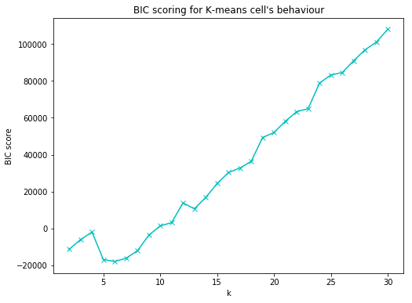
Clustering Model
Standardize the data, before passing the data to the K-Means Clustering model
Choose the cluster size to be 5, so that it minimizes the Bayesian Information Criterion (BIC)

Slide 20
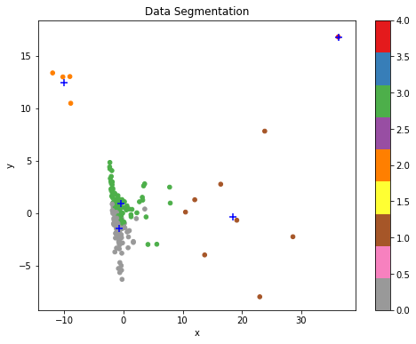
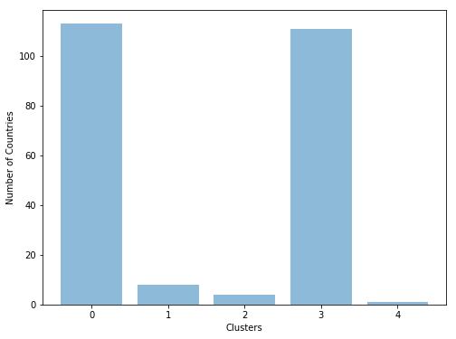
Clustering Model
Perform PCA, to reduce the feature dimension to 2D, along the two largest principal directions, so that we can visualize the data
The Left plot shows the clusters for the provided countries and the Right plot shows the distribution of data points between the clusters.

Slide 21
Insights
Looking at the aggregated data at the Country level, we can say the following regarding the clusters
The Countries belonging to Cluster 0, spend less amount on in-game transactions, but spend a lot of time in-game. Geographically, this makes sense, since these are small and comparitively poor countries, in Asia, Africa, and Central Europe. (Eg: Afghanistan, Somalia, Syria, Armenia)
The Countries belonging to Cluster 1, contribute significantly, to the number of active users, but also spend a lot more on in-game transactions, while spending lesser time in game than Countries in cluster 0. Geographically, these countries are relatively rich and developed, and hence the insight makes sense. (Eg: United States, Japan, Malaysia, Turkey)

Slide 22
Clustering Model
The Countries belonging to Cluster 2, do not spend much time and money in-game. Also, these countries had some Mandarin names which makes reasoning about them geographically, quite difficult. These Countries could very well be outliers.
The Countries in Cluster 3, are similar to countries in Cluster 1, in that they geographically correspond to developed nations in Europe, Americas, and Australia. These countries, do not spend much time or money in-game, unlike Cluster 1. But they spend a similar amount of money in-game to Cluster 0, while spending way less time in-game. These Countries have not been tapped into as much, and are excellent candidates for targeted promotions. Examples of such countries in Cluster 3, are China, Australia, Spain, Sweden etc.
The Country, that belongs to Cluster 4 is India. This Country, contributes a significant proportion to the Daily Active User base, and also spends the most amount of money in-game, while spending lesser time in-game than Cluster 0. India, seems to be a valuable contributor to the business, and also has an extremely high conversion rate. The Customers in India, are fully tapped into the game, and need to be retained. This Cluster could also be grouped along with Cluster 1, keeping in mind, that Cluster 4 contains only a single country (India).

Slide 23
THANK YOU

